Slide 1
UI Elements and Events
Jianjun.Chen@xjtlu.edu.cn

Slide 2
Contents
Activity
Layout and View Concepts
Designing Layout
Handling Events

Slide 3
The res Folder and R.java
Most resources in res folder will be assigned with an integer type ID number by Android Asset Packaging Tool (AAPT) in R.java
Each type of resource in res folder is associated with a static nested class in R.java.
Layouts
Mipmaps
Drawables
Strings
…
Your can use R.java to access the corresponding resource elements. The general format is:
R.<resource_type>.<resource_name>

Slide 4
R.java
“setContentView(R.layout.activity_main)”
public final class R {
public static final class layout {
public static final int activity_main=0x7f0a001c; public static final int activity_main2=0x7f0a001d;
}
public static final class drawable {
// IDs for the images in drawable folder
}
public static final class string {
public static final int app_name=0x7f0c001b;
// other string values in strings.xml
}
}
res/layout/activity_main.xml
res/layout/activity_main2.xml
res/values/strings.xml

Slide 5

Activity
Activity life circle, Transferring data

Slide 6
Activity
Primary class for interacting with user.
In principle, each activity is associated with one UI.
Each app can have one or more activities
One or more activities can be defined as launcher activities that serve as entry points of an app. (Like main())
Each launcher activity creates a corresponding icon in the app launcher once the app is installed on the system.
Usually, each app has only one launcher activity.
One activity can start another activity in the same app or in a different app.
Notes:
If you define 2 launcher activities, your app will have 2 icons in the app launcher

Slide 7
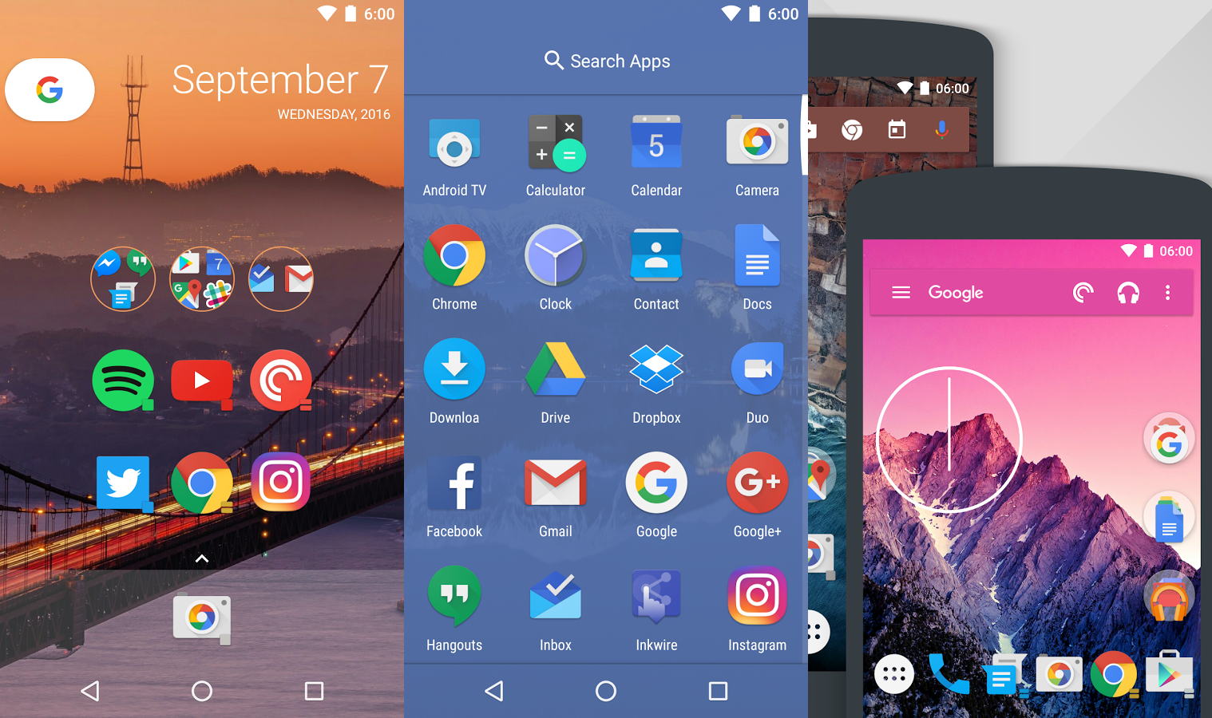
App Launcher
Below are screenshots of different app launchers.
They are system-level apps that manage other apps.
Tapping on each icon will start the launcher activity of the corresponding app.
Notes:
http://phandroid.com/wp-content/uploads/2017/02/actionlauncher.png

Slide 8
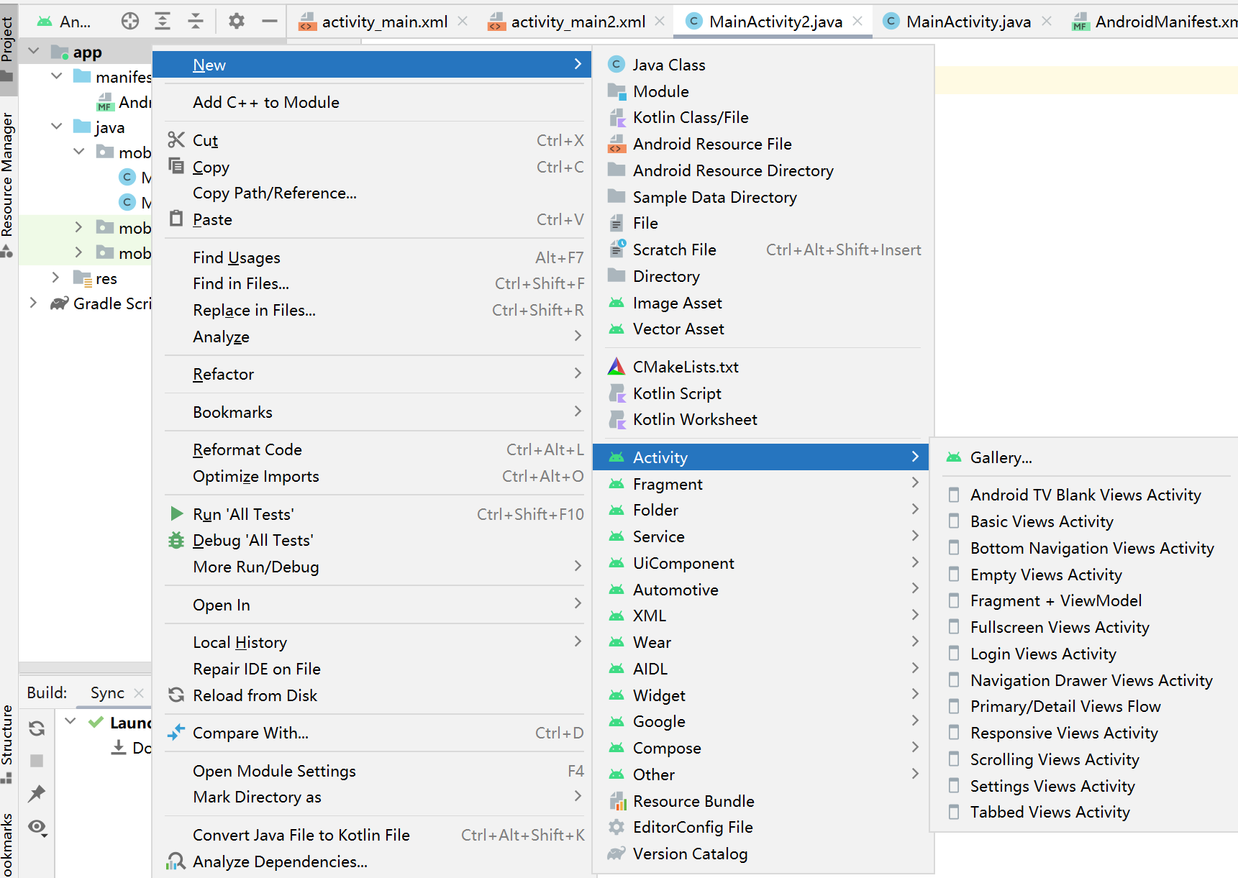
Creating an Activity

Slide 9
Activity-related Files and Code
Each activity must have a corresponding Java class that inherits Android.app.Activity or its subclasses.
An activity is usually associated with a layout.
Layouts are defined using an XML file stored in “res/layout” project folder.
The layout XML describes what widgets are used and how they are placed on the screen.
Layout is loaded by calling setContentView(), which is usually done in onCreate() function of that Activity.
Activities must be registered in “AndroidManifest.xml”.

Slide 10
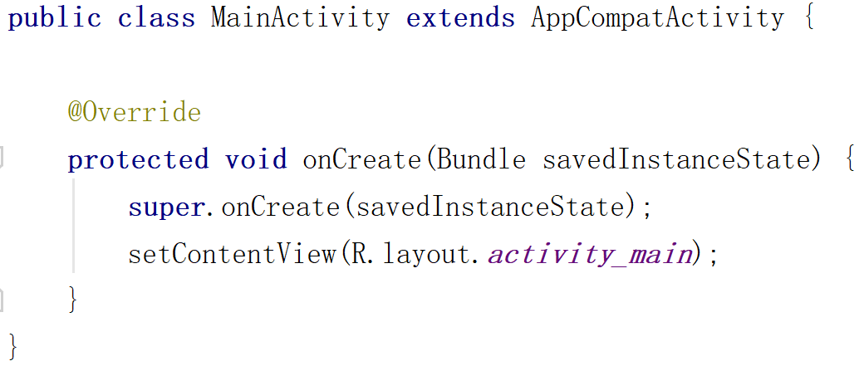
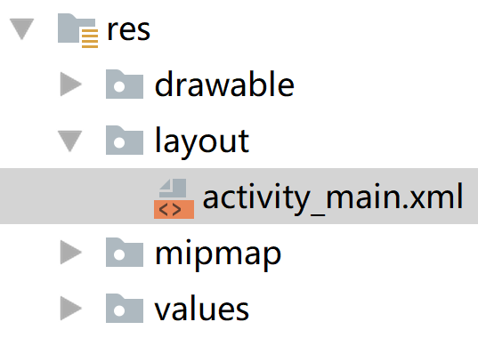
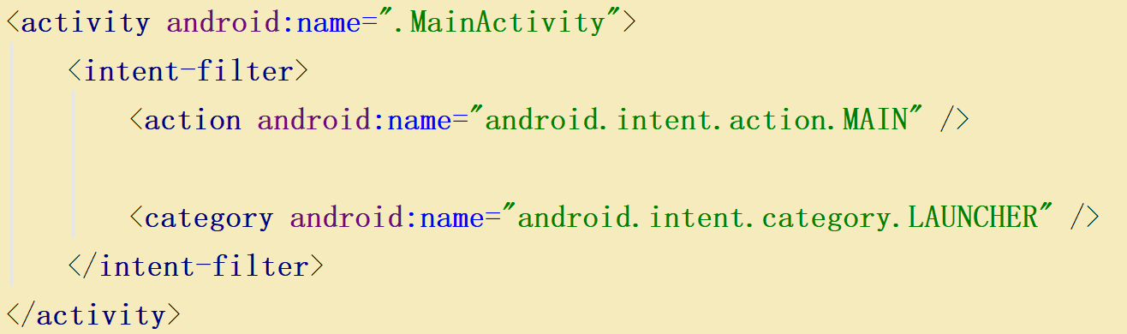
1
3
2
This activity is the entry point for this app
4
This activity will appear as an icon in the app launcher

Slide 11
Starting Activities
Activities can be started by calling the function:
The Intent object contains the information of the target activity.
You can start an activity using the activity class name explicitly:
But in many cases, you don’t know the activity name that can handle a certain request.
You can let the Android system to choose one for you by using an implicit intent (an example will be given later).
startActivity(Intent intent)
startActivity(new Intent(this, Activity2.class));
Notes:
For instance, to let Android system choose an suitable activity (from) for sending email:
Intent intent = new Intent(Intent.ACTION_SEND);
Intent.putExtra(Intent.EXTRA_EMAIL, recipientArray);
startActivity(intent);

Slide 12

Starting Activities: Example
When a user tap on the WeChat icon, its corresponding greeting page will be shown.
The Android system invokes the launcher activity of WeChat.
Apps that request for online payment (such as railway ticket payment) can directly reach the payment page.
Another app invokes the payment activity of WeChat.
By scanning a QR code using WeChat, the payment page can also be reached.
Notes:
This is only observations. Real WeChat could use different mechanism

Slide 13
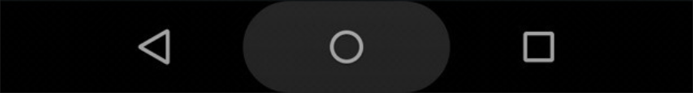
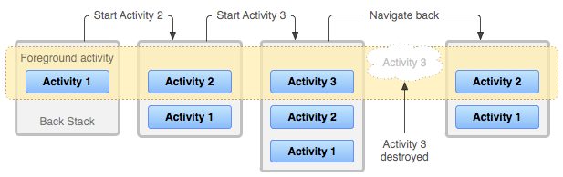
Activity “Back Stack”
Back button
When a new activity is launched, the previous activity will be paused and sent to the top of the back stack.
Activities in the back stack follows the rule of last-in-first-out.
When the user clicks “back” button, the current activity will be destroyed.
The top activity in the back stack will be activated and shown.

Slide 14
Activity Life Cycle
An activity has four states in its life cycle.
Running: the activity is on the top of the screen and gained focus.
Paused: the activity is partially covered by other activities.
Stopped: the activity is completely covered by another running activity.
Destroyed.
When running short of memory, a stopped activity is more likely to get killed than a paused/running activity.
Each time the state of an activity is changed, its corresponding callback functions will be invoked.

Slide 15
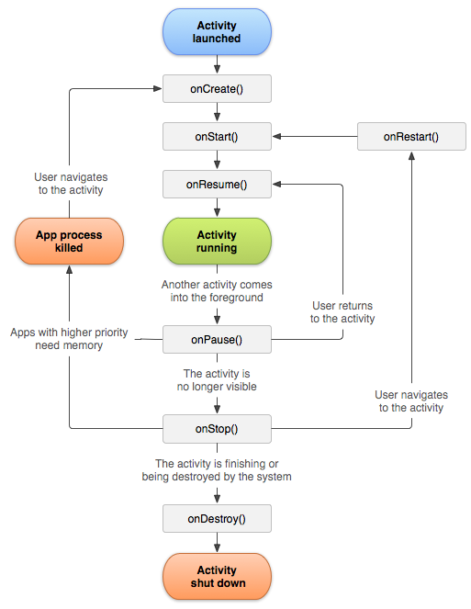
Activity State Change
When an activity is started:
OnCreate -> onStart -> onResume.
Loses focus and become invisible:
onPause -> onStop.
Recaptured focus:
OnRestart -> onStart -> onResume.
Closed:
onPause -> onStop -> onDestroy.

Slide 16
Callback Functions: Typical Uses
*The points above are very general. Carefully design your app and keep the life cycle graph in mind.
Function | Typical Use
onCreate() | Initial setup, load persistent state.
onRestart() | read cached state
onStart() | reset application
onResume() | start foreground-only behaviors
onPause() | shutdown foreground-only behaviors (like animations)
onStop() | cache state
onDestroy() | save persistent state

Slide 17
Callback Functions
Good implementation of callback functions can make your app more robust and performant.
Possible issues with a bad implementation:
Crashing if the user receives a phone call or switches to another app while using your app.
Consuming valuable system resources when the user is not actively using it.
Losing the user's progress if they leave your app and return to it at a later time.
Crashing or losing the user's progress when the screen rotates between landscape and portrait orientation.

Slide 18
Passing Data to Activity
To pass data to the activity you want to start, you can embed data into intent:
Embed data in Intent and start activity:
Intent toPayment = new Intent(this, PaymentActivity.class); toPayment.putExtra("cost", roomCost); toPayment.putExtra("roomNumber", room); startActivity(toPayment);
Key-value pairs like Map
This is the default value, if the key “cost” is not set previously, this value will be obtained.
Inside PaymentActivity.onCreate():
Intent payRequest = getIntent(); int payAmount = payRequest.getIntExtra("cost", 0);
int roomNum = payRequest.getIntExtra("roomNumber", 0);

Slide 19
Passing Data to Activity
The code below has the same effect as the previous example
Embed data in Intent and start activity:
Intent toPayment = new Intent(this, PaymentActivity.class); Bundle bundle = new Bundle(); bundle.putInt("cost", roomCost); bundle.putInt("roomNumber", room); toPayment.putExtras(bundle); startActivity(toPayment);
Bundle allows one to extract or store all key-value pairs in one go. No need to copy them one-by-one from Intent
Inside PaymentActivity.onCreate():
Intent payRequest = getIntent(); Bundle bundle = payRequest.getExtras(); int cost = bundle.getInt("Cost");
……
Notes:
Can be useful when you need to forward contents of an Intent.

Slide 20
Passing Data then Receive Data
Sometimes one needs to start another activity then obtain some results from it.
For example: an activity starts the Contacts app in order to let the user to select a contact.
Once a contact is selected, the activity will receive the contact details as a result.
Another example: an activity starts the Camera app to take a photo and return the photo image as the result.

Slide 21
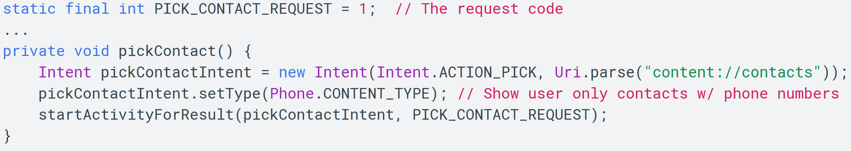
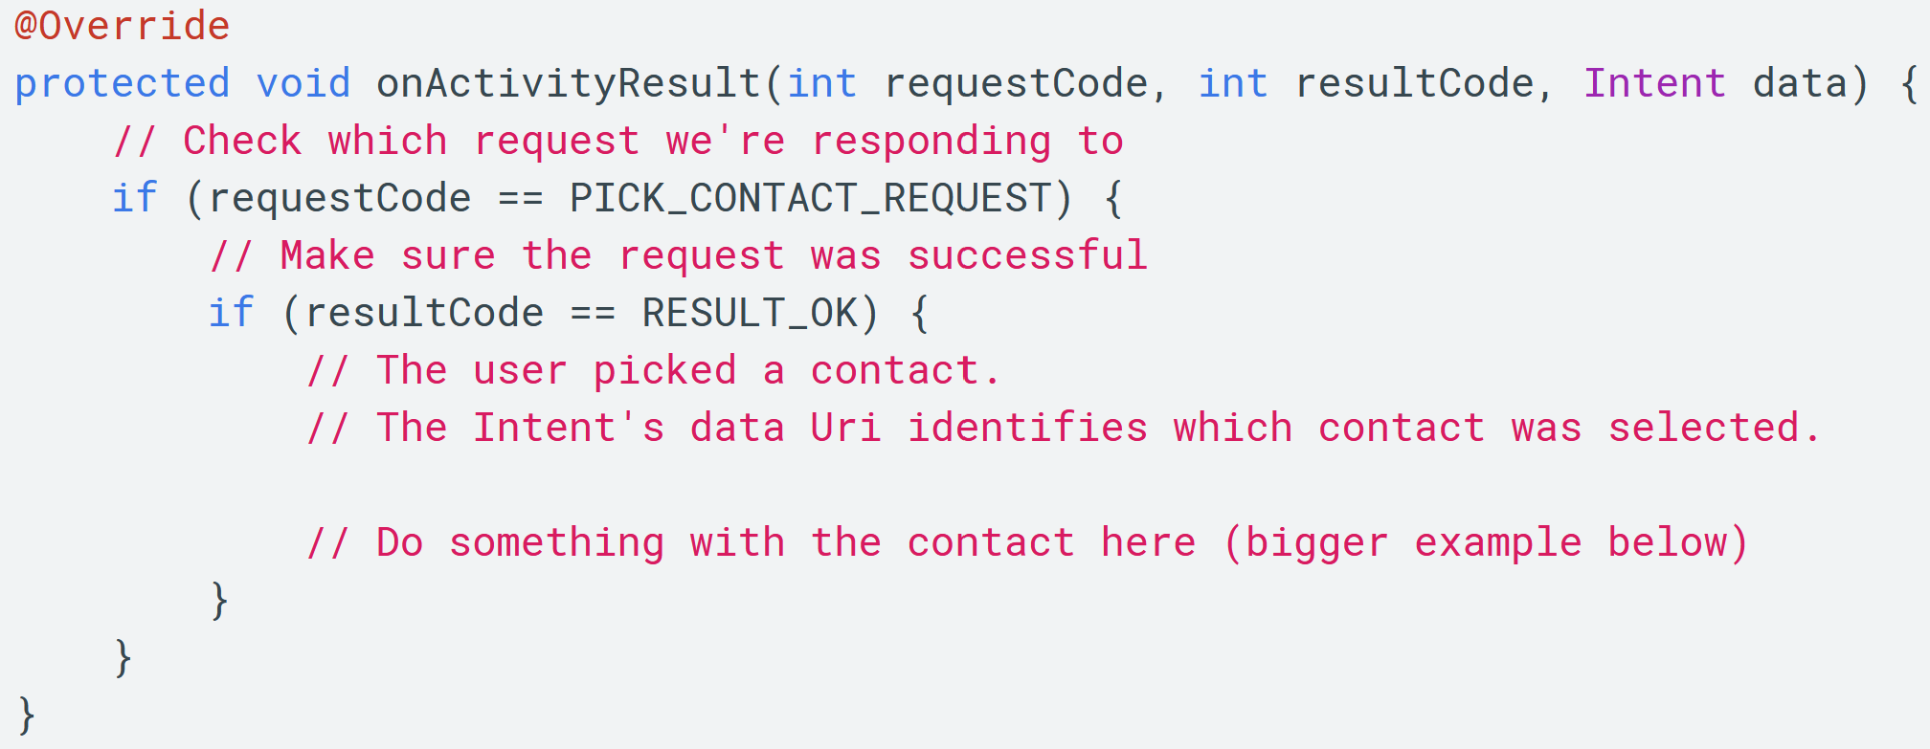
To start the activity:
To receive the result:
You may send requests to different activities. Request code can help you identify different cases.

Slide 22
Passing Data then Receive Data
Choose room
Choose bank card
Another example: hotel room booking.
No: back to Payment
Yes: back to choose room

Slide 23
Passing Data then Receive Data
The general workflow:
In activity 1:
startActivityForResult(intent,
CONFIRM_BOOK_REQUEST);
In activity 2:
1
Intent returnContent = new Intent(); returnContent.putExtra("room_booked", true); setResult(RESULT_OK, returnContent); finish();
In activity 1:
2
protected void onActivityResult(int requestCode,
int resultCode, Intent data) { if (requestCode != CONFIRM_BOOK_REQUEST) return; switch (resultCode) { case RESULT_OK: …… } }
Check the uploaded project files on module page for the full source code
3

Slide 24
Returning Results
Intent is only suitable for passing small amount of data.
To transfer large pieces of data, consider storing data as a file and then read it later.
In addition, startActivityForResult() is now labelled as deprecated. New method can be found here:
https://www.codingdemos.com/android-onactivityresult-is-deprecated-now-what/

Slide 25
Closing Activities
Android will automatically manage the life cycles of your activities.
You can destroy the current activity manually by calling finish().
To finish an activity that you previously invoked with startActivityForResult(Intent, int), use finishActivity(int requestCode).
Can be handy when you want to make sure that the user won’t return to this activity in the future.

Slide 26
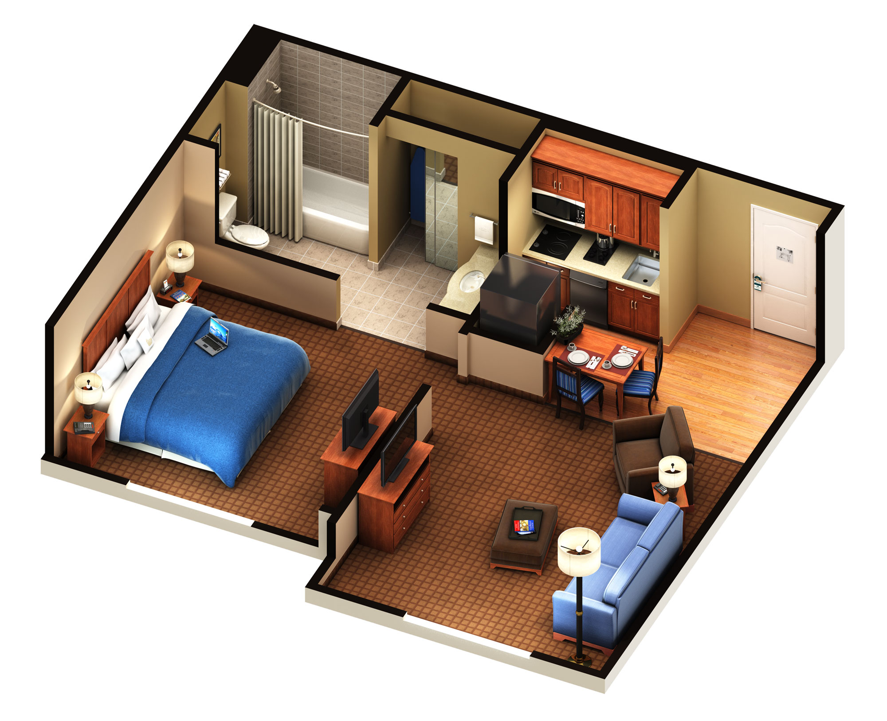
Layout and View
The View class, Layout and View properties(XML attributes), Layouts
Notes:
https://www.tourismburlington.com/wp-content/uploads/2013/05/1RoomSuite.jpg

Slide 27
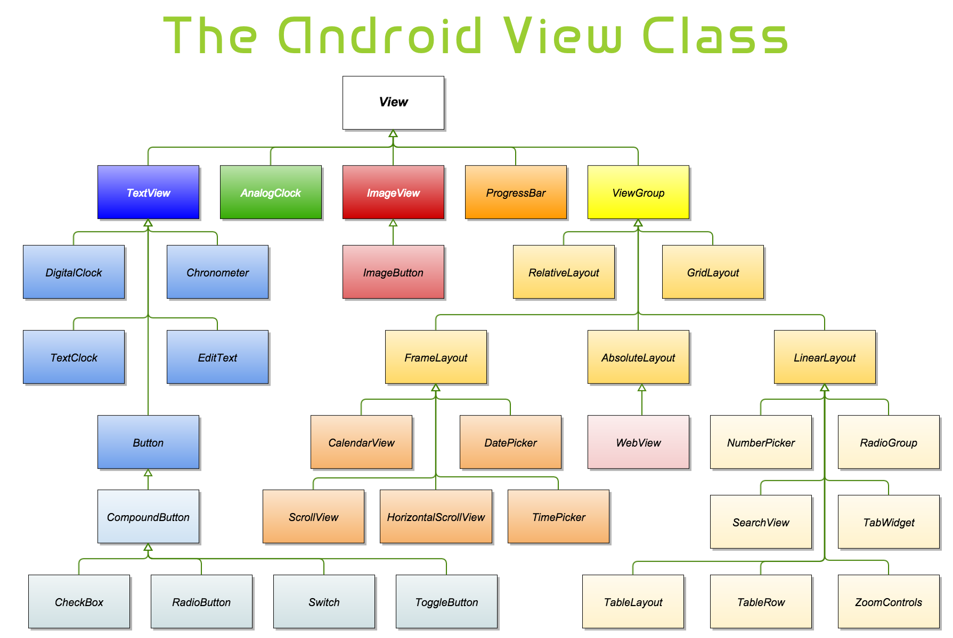

Slide 28
Base Classes of UI
The base class of widgets is View.
Button, List, EditText, Checkbox …
A View occupies a rectangle area on the screen.
It renders its visual elements in this area.
It also handles the events that take place in this area.
The base class of layouts is ViewGroup.
ViewGroup itself is a subclass of View. It’s a widget that contains other widgets.
ViewGroup automatically arranges positions of the Views that are added to it.

Slide 29
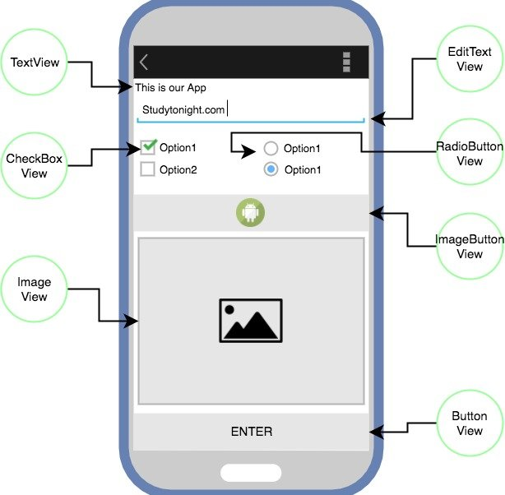
Views Example
Notes:
https://static.studytonight.com/android/images/android-view-types.jpg

Slide 30


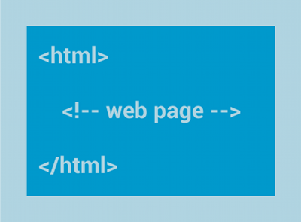
Some Layouts
Linear layout: vertical/horizontal
A scroll bar will be automatically added if the total height/width exceeds the length of the screen.
Relative/Constraint layout:
specify the location of child objects relative to each other (child A to the left of child B) or to the parent (aligned to the top of the parent).
Web view:
you can create your own web browser based on it

Slide 31
Other Layouts
Details are available in the API reference.
FrameLayout
TableLayout
AbsoluteLayout
GridLayout
…
You can add another ViewGroup to a ViewGroup.
You can start by following the API reference for ViewGroup, as all these layouts are it’s subclasses

Slide 32
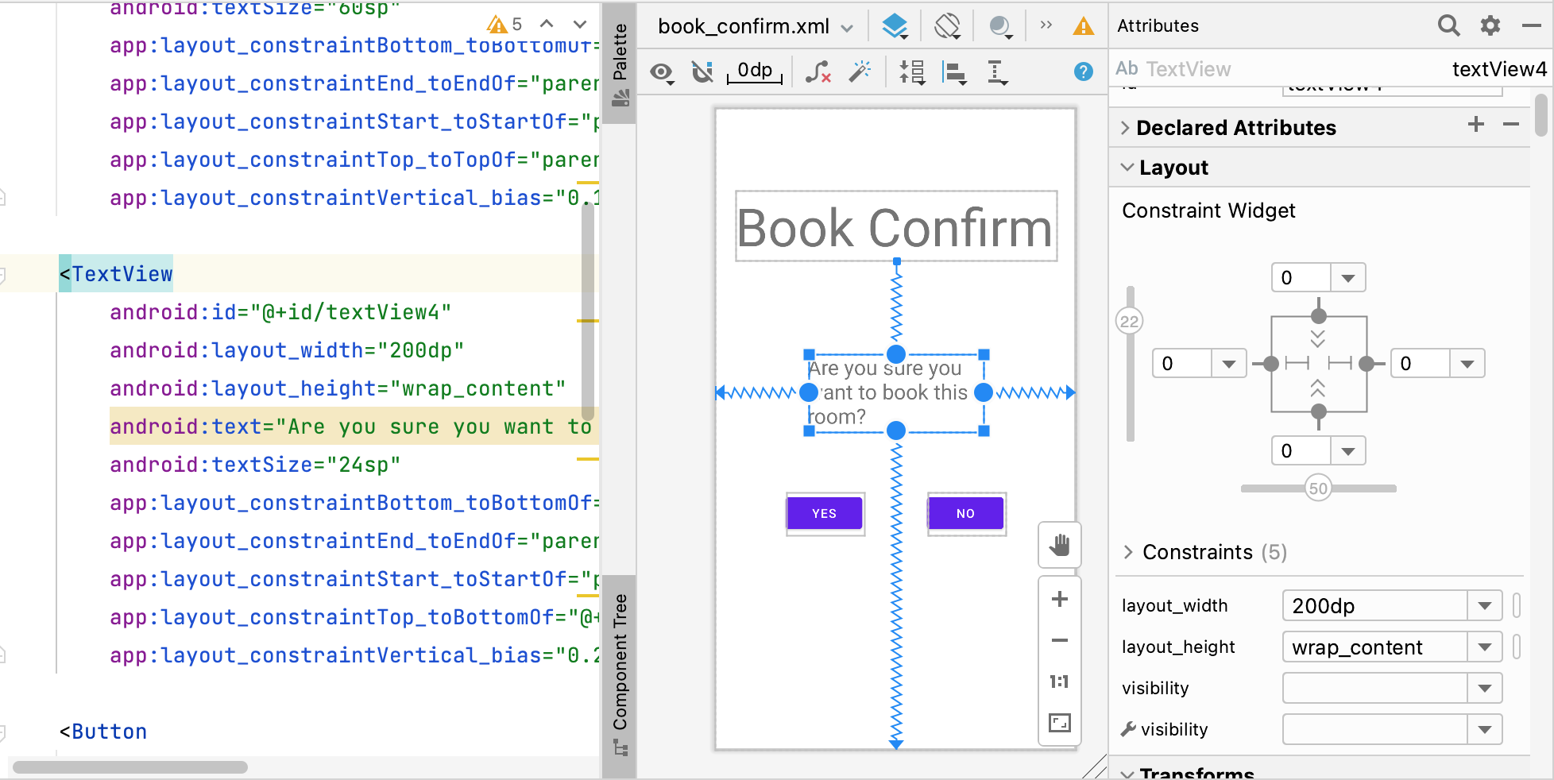
Layout XML Attributes
You can change the settings of Views and ViewGroups in the UI designer or in the layout XML directly.

Slide 33
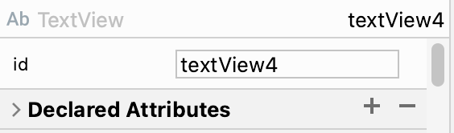
Important Properties: ID
View ID: Unique identifier for Views
ID can be used to get a reference to the TextView or Button you created in the layout XML file.
android:id="@+id/textView4"
TextView label = findViewById(R.id.textView4); label.setText("Type your text below");
Button bookYesBtn = findViewById(R.id.bookYesBtn);

Slide 34
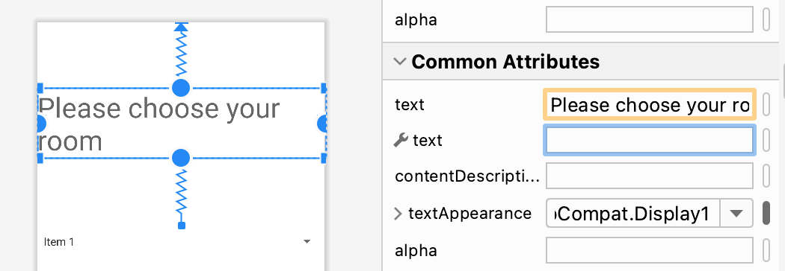
Important Properties: Text
Text: Sets the text shown on buttons and labels (TextView).
If you want to provide multilingual support for your app, you should define strings in “strings.xml” and provide translations for each string.
Then set the text of Buttons and TextViews to these strings.
android:text="Please choose your room"

Slide 35
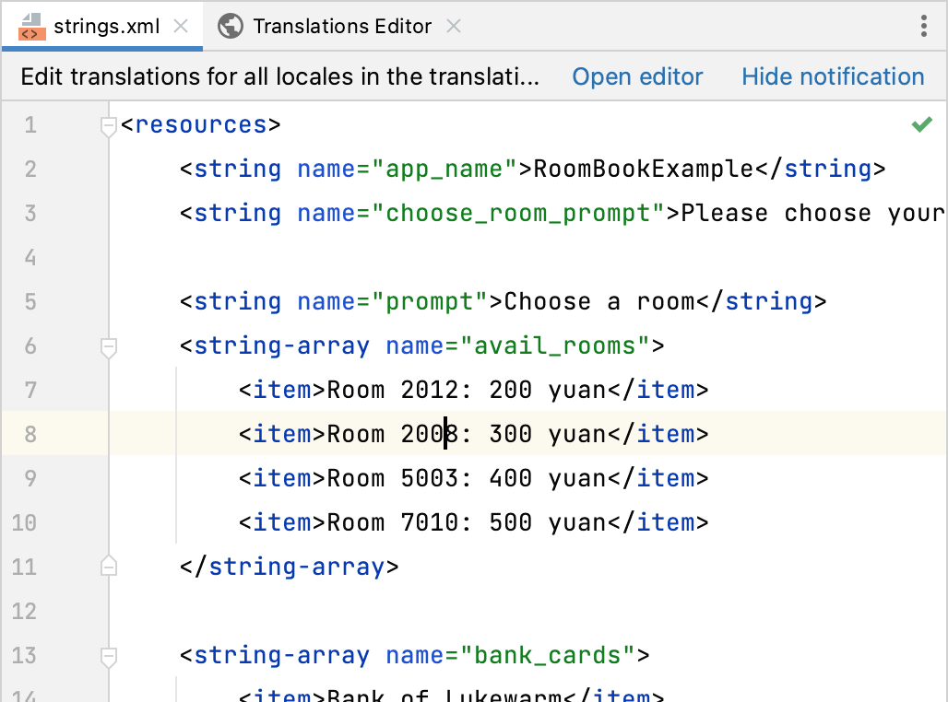
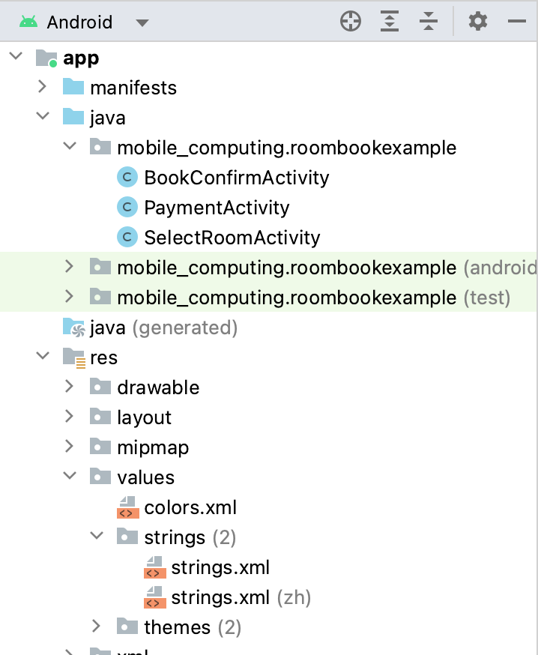
Defining Text in “strings.xml”
Format:
<string name="name">Actual String Content</string>

Slide 36
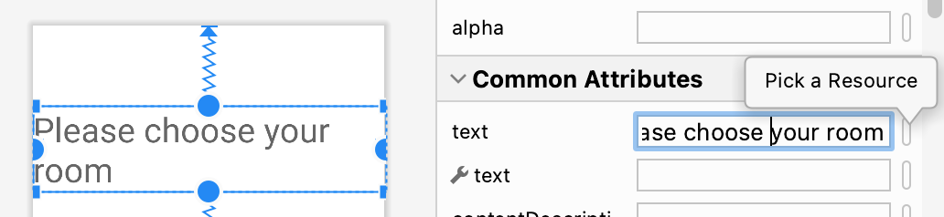
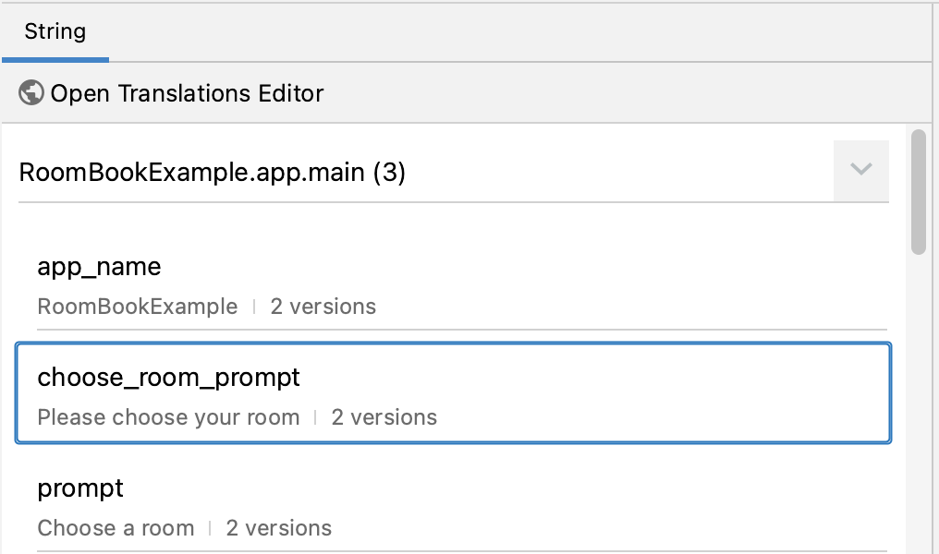
Set Text in Buttons and Labels
Click on the tiny button right next to the “text” attribute in the UI designer:
Then select the text: Or edit the Layout XML directly:
<TextView android:id="@+id/textView3" android:layout_width="wrap_content" android:layout_height="wrap_content" android:text="@string/choose_room_prompt"

Slide 37
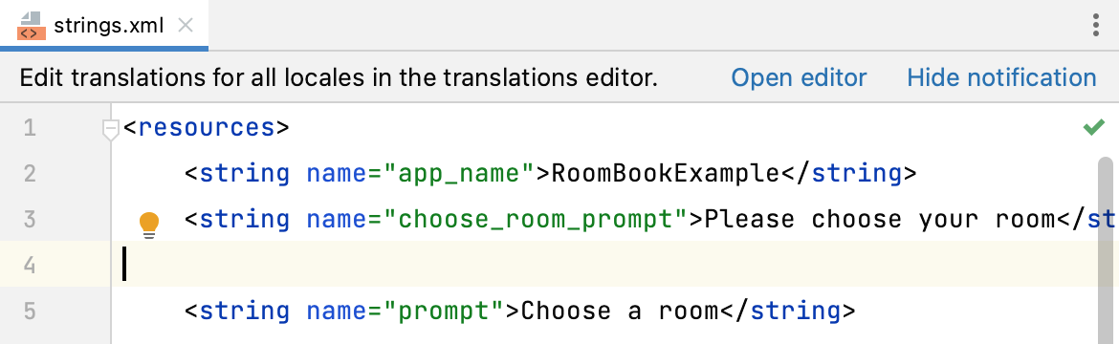
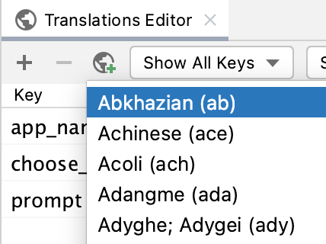
Create New Language Support
Open the translations editor
Then click the globe and add a new language

Slide 38
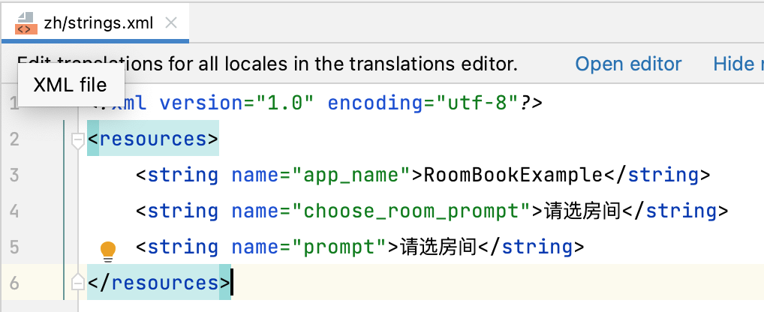
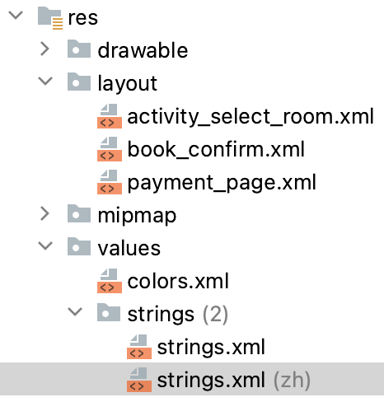
Create New Language Support
A new “strings.xml” for that language will be created.
You can add translations to strings in this new file.

Slide 39
Important Properties: Layout Params
You can specify width and height directly to widgets using units like dp or let the layout manager decide:
There are 2 special values:
wrap_content: the minimal value needed to display the widget’s content.
match_parent: this view should be as big as its parent (the layout that contains this view)
android:layout_width="200dp" android:layout_height="40dp"
android:layout_width="wrap_content" android:layout_height="wrap_content"

Slide 40
Units of Measurement
Pixel (px): actual pixels on the screen.
Inch (in): physical size of the screen.
1 Inch = 2.54 centimetres
Millimetre (mm)
Points (pt): 1/72 of an inch.
Density-independent Pixel (dp or dip):
An abstract unit that is based on the physical density of the screen. These units are relative to a 160-dpi screen.
Using dp can ensure proper display of your UI on screens with different dpi settings.
px = dp * (dpi / 160)
Scale-independent Pixels (sp):
Similar to dp, but also scaled by the user's font size preference.

Slide 41
Layout Params: Padding and Margin
In addition to width and height, there are two related layout parameters:
Padding: is still a part of a View.
Setting the background colour of a View, and the background colour will extend to the padding area.
View.getWidth() and View.getHeight() will report the dimension including the padding area.
we can increase the padding size of a view to make it look bigger.
Margin: is not a part of a View.
But other views are not supposed to cover this area.
We can use margin to create empty space around a view where other views cannot (normally) occupy.

Slide 42
Padding and Margin
This gray area receives UI events
This area is allocated to this TextView
Margin@Top
Padding@Top
TextView
Widget’s original frame, the size of “wrap_content”

Slide 43
Controlling Padding and Margin
Padding can be configured using XML attribute:
android:padding="12dp"
You can also set paddings for individual directions:
android:paddingBottom="22dp"
Margin configuration:
android:layout_margin="20dp"
android:layout_marginRight="20dp"

Slide 44
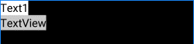
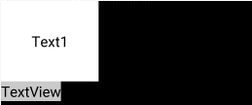
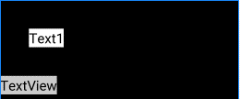
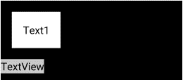
<TextView android:id="@+id/textView" android:layout_width="wrap_content" android:layout_height="wrap_content" android:padding="0dp" android:background="#FFFFFF" android:text="Text1" android:textColor="#000000" android:textSize="24sp" />
android:padding="50dp"
android:layout_margin="50dp"
android:padding="25dp" android:layout_margin="25dp"

Slide 45
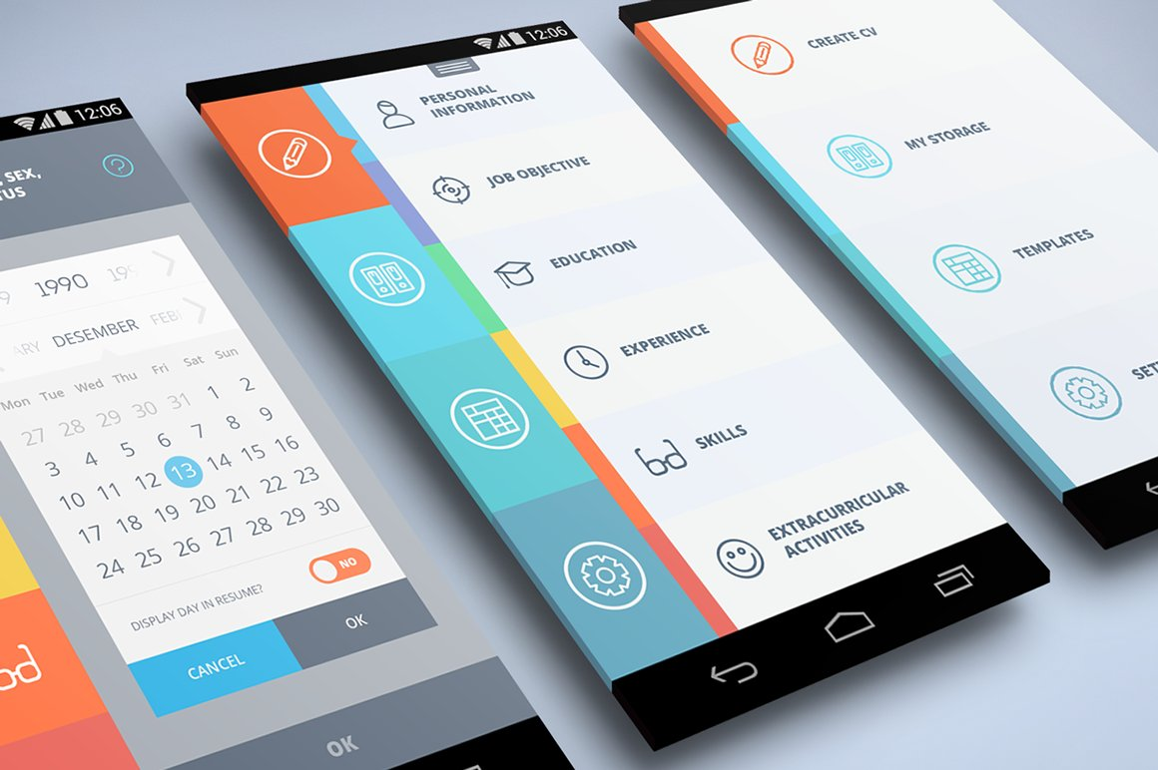
Designing Layouts
ConstraintLayout, Same layout under different screen resolutions

Slide 46
Constraint Layout
Introduced since API level 9.
Now the default layout when a new empty activity is created.
The constraint layout arranges everything inside by assigning constraints for every child view/widget relative to other views present.
The constraint layout is to improve the performance of the applications by removing the nested views with a flat and flexible design.

Slide 47
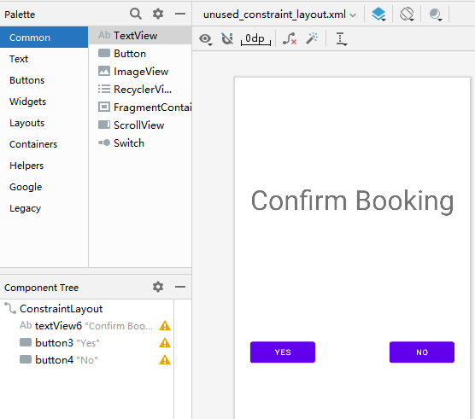
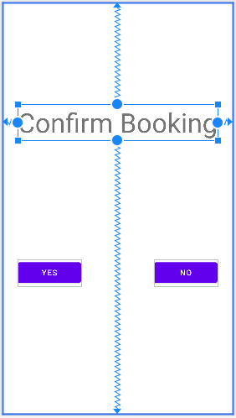
Constraint Layout: Adding Views
To add a View into Constraint Layout, simply drag it from the “Palette” window.
Clicking on the View just added, you can resize or re-position the view.

Slide 48
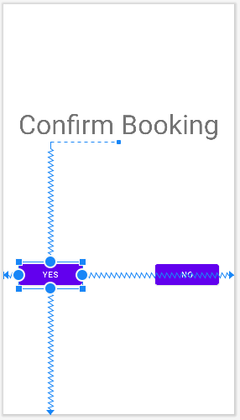
Constraint Layout: Relative Positioning
The position of a view is specified using the relative position of the four edges of this view to other views.
“parent” means the container of this view (the layout it belongs to)
The red dotted square is the bounding box of the possible position of the “Yes” button.
<Button android:id="@+id/book_yes_btn" android:layout_width="114dp" android:layout_height="48dp" android:text="Yes" app:layout_constraintBottom_toBottomOf="parent" app:layout_constraintEnd_toEndOf="parent" app:layout_constraintHorizontal_bias="0.09" app:layout_constraintStart_toStartOf="parent" app:layout_constraintTop_toBottomOf="@+id/confirm_booking_label" app:layout_constraintVertical_bias="0.486" />

Slide 49
Constraint Layout: Relative Positioning
The two bias values specifies the relative position within the bounding box.
0 means leftmost/topmost
1 means rightmost/bottommost
0.5 means at the center.
<Button android:id="@+id/book_yes_btn" android:layout_width="114dp" android:layout_height="48dp" android:text="Yes" app:layout_constraintBottom_toBottomOf="parent" app:layout_constraintEnd_toEndOf="parent" app:layout_constraintHorizontal_bias="0.09" app:layout_constraintStart_toStartOf="parent" app:layout_constraintTop_toBottomOf="@+id/confirm_booking_label" app:layout_constraintVertical_bias="0.486" />

Slide 50
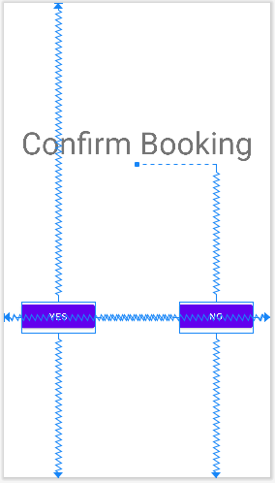
Constraint Layout: Different Screens
In this example, the two buttons look perfectly aligned.
The “Yes” button:
The “No” button:
app:layout_constraintTop_toTopOf="parent“
app:layout_constraintBottom_toBottomOf="parent" app:layout_constraintVertical_bias="0.672"
app:layout_constraintTop_toBottomOf
="@+id/confirm_booking_label" app:layout_constraintBottom_toBottomOf="parent" app:layout_constraintVertical_bias="0.486"

Slide 51
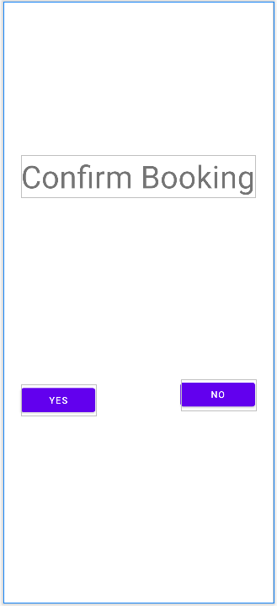
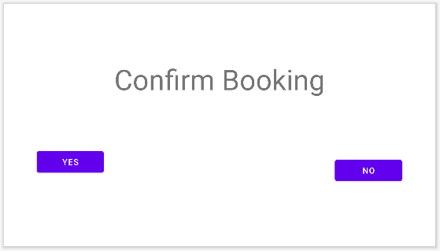
Constraint Layout: Different Screens
But if you apply this layout to a different screen aspect ratio, or rotate it, these two buttons are not aligned properly.
Because the top and button edge of the two buttons are relative to different edges.
Google Pixel 7
Google Pixel
Google Pixel landscape

Slide 52
Test your UI on different screens!
Google Pixel 7
Google Pixel
Google Pixel landscape

Slide 53
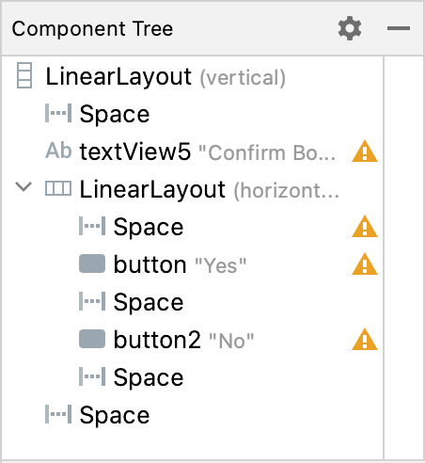
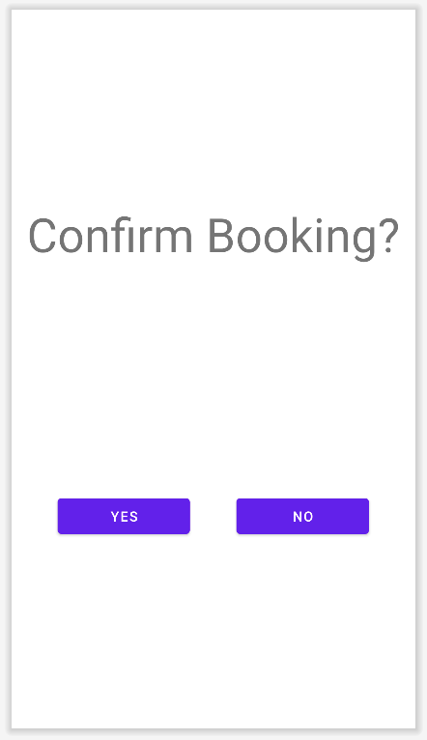
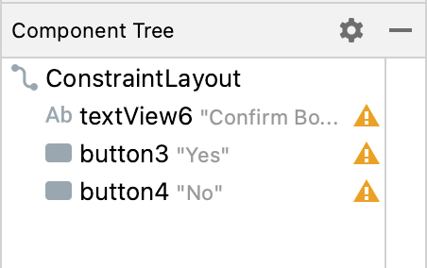
Constraint Layout: Advantage
In the example below, constraint layout and linear layout are used to design the same UI.
Constraint layout has simpler hierarchy, thus has reduced complexity in calculating the coordinates and sizes of views.

Slide 54

Handling Events
Spinner example

Slide 55
Events
Android supports various user interaction events:
Click, long click (click and hold), drag, key press,
To receive a certain type of event, you need to implement its event listener and register it to the View.
Several listener interfaces are defined inside View:
View.OnClickListener
View.OnDragListener
View.OnLayoutChangeListener
Each listener contains only one callback method.
E.g. onClick() in View.OnClickListener.
Register the listener by calling View.setXXXListener(Listener)

Slide 56
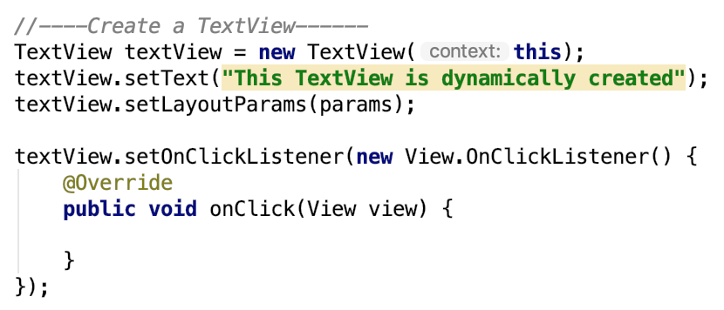
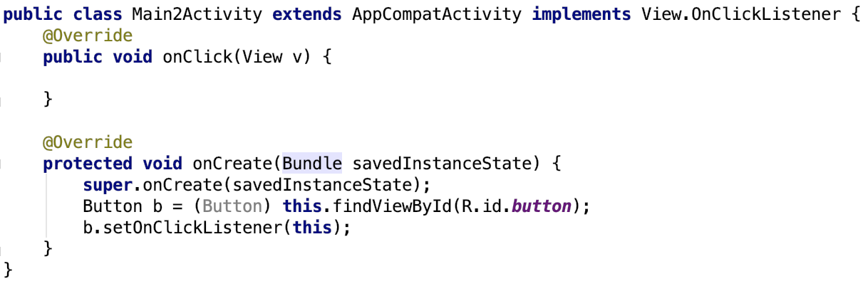
Event Listener Example 1 & 2

Slide 57
Event Listener Example 3: Spinner
Widgets like Spinner and ListView and GridView are capable of offering multiple choices to users.
Here, Spinner will be used as an example.
Assume we want to know the favourite activity of a user. You can create a spinner using:
UI Designer with predefined choices in “string.xml”.
Java code with dynamically created choices.

Slide 58
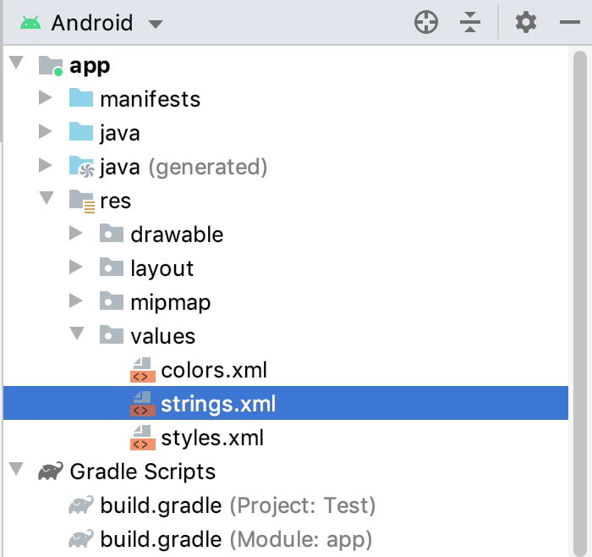
Spinner How-to
Step 1: create spinner prompt and options in strings.xml
<string name="prompt">Choose a hobby</string> <string-array name="hobbies"> <item>A</item> <item>B</item> <item>C</item> <item>D</item> </string-array>

Slide 59
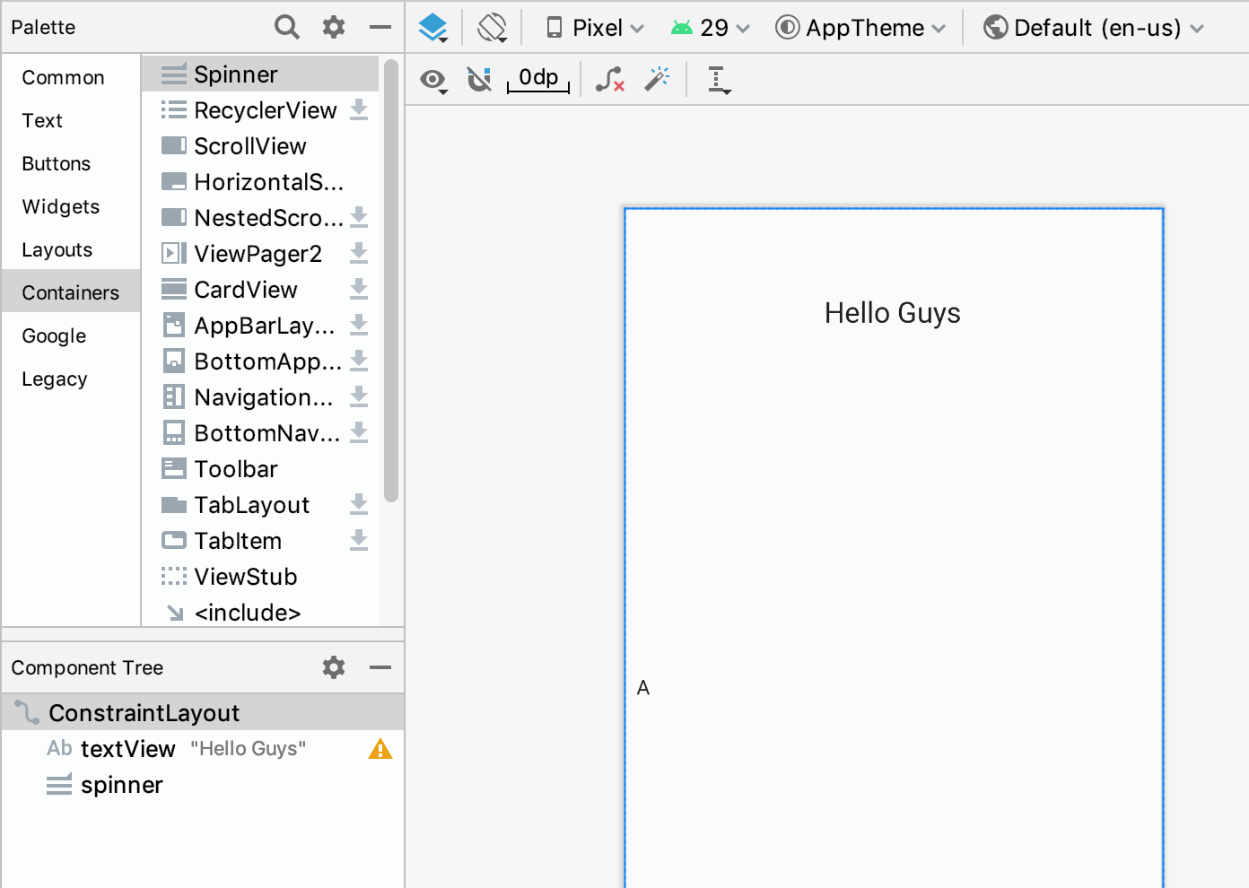
Spinner How-to
Step 2: Add the Spinner into the layout.
Open the layout, and add spinner into the layout.

Slide 60
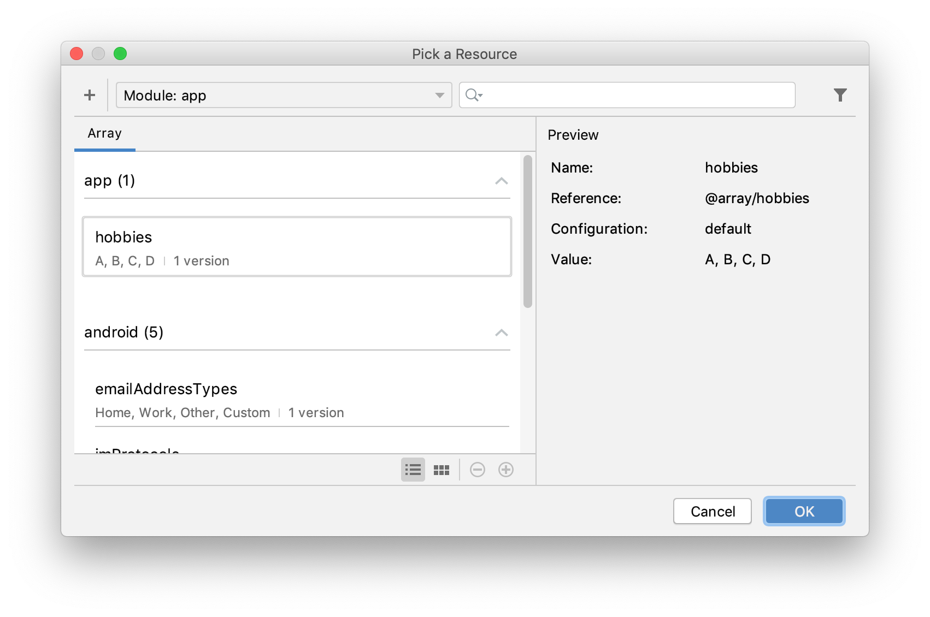
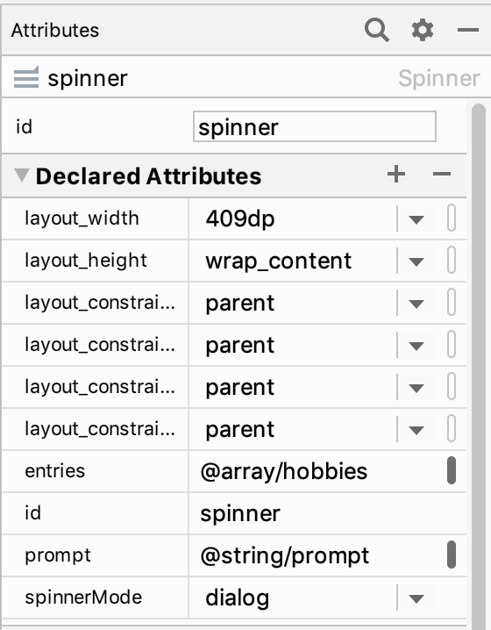
Spinner How-to
Step 3: Add the strings you defined in step 1.
In “declared attributes”, choose the prompt as well as the string array.
Click on this tiny button

Slide 61
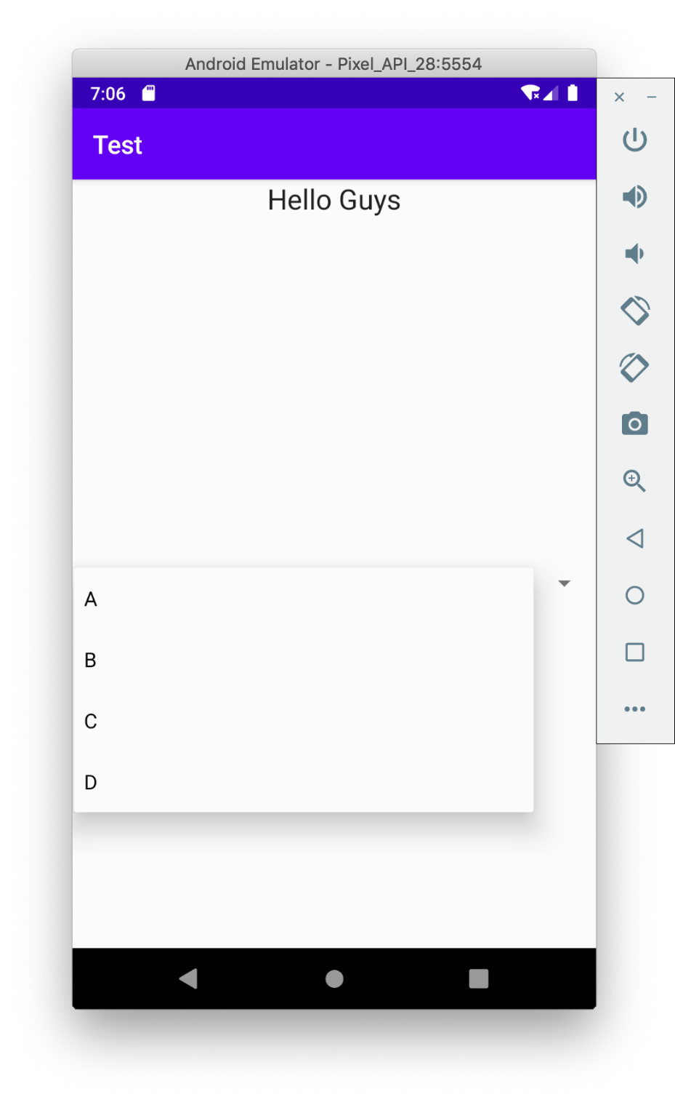
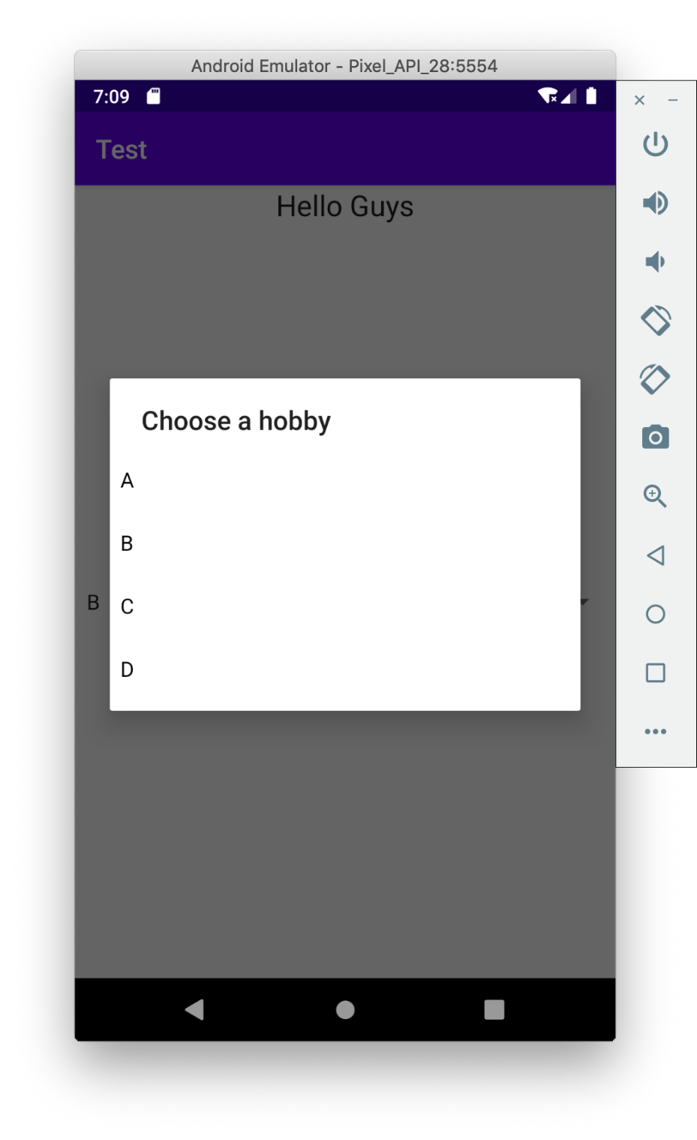
Spinner How-to
Step 4: Choose spinner mode: dialog or dropdown
Dropdown: No prompt
Dialog: shows the prompt

Slide 62
Spinner How-to
Step 5: Implement OnItemSelectedListener.
final Spinner s = findViewById(R.id.spinner); s.setOnItemSelectedListener(new Spinner.OnItemSelectedListener() { @Override public void onItemSelected(AdapterView<?> parent, View view, int position, long id) { …… } @Override public void onNothingSelected(AdapterView<?> parent) { } });
https://stackoverflow.com/questions/3009745/what-does-the-question-mark-in-java-generics-type-parameter-mean

Slide 63
onItemSelected()
Parameters:
parent – The AdapterView where the selection happened
view – The view within the AdapterView that was clicked
position – The position of the view in the adapter
id – The row id of the item that is selected
https://stackoverflow.com/questions/12965817/practical-difference-between-position-and-row-id-in-onlistitemclick
public void onItemSelected(AdapterView<?> parent, View view, int position, long id) { …… }

Slide 64
Manually Adding Items
The code below manually adds items to the spinner.
Spinner spinner2 = (Spinner) findViewById(R.id.spinner2); List<String> list = new ArrayList<String>(); list.add("Sing"); list.add("Dance"); list.add("Rap"); list.add("Basketball"); ArrayAdapter<String> dataAdapter = new ArrayAdapter<String> (this, android.R.layout.simple_spinner_item, list); spinner2.setAdapter(dataAdapter);

Slide 65
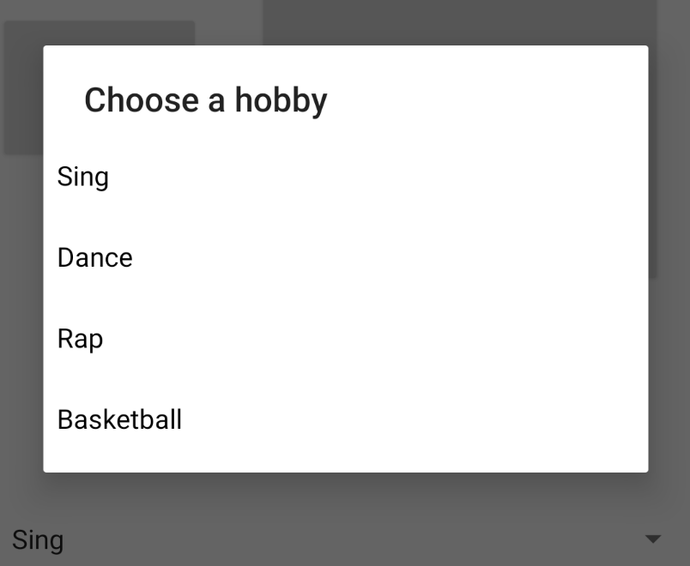
Extended Reading
An AdapterView is a view whose children are determined by an Adapter.

Slide 66
Adapter & Adapter View
The ArrayAdapter we saw is a BaseAdapter backed by an array of arbitrary objects.
It’s a subclass of BaseAdapter
A BaseAdapter is an implementation of Adapter interface that can support ListView and Spinner.
An Adapter object acts as a bridge between an AdapterView and the underlying data for that view.
An AdapterView is a View whose children are determined by an Adapter.
Spinner, ListView, GridView are different AdapterViews.

Slide 67
Lab Session Task 1:
Extend the RoomBookingExample project so that all booked rooms appear as a list on the first room booking activity (launcher activity)

Slide 68
Lab Session Task 2:
Write a simple app that:
Has two activities with different UIs.
Shows the main activity with some greeting messages for 5 seconds.
Then automatically jumps to its second activity.
Now press “back”, does it still jump to the second activity?
What can be done to prevent this?
Implement onStop() and let it print out some messages.
Try to rotate your screen. What will happen?
Try to turn the screen on and off. What will happen?

Slide 69
Extended Learning
How to find view’s dimensions before displaying the view
https://spotandroid.com/2016/12/21/android-tricks-how-to-find-views-dimensions-before-displaying-the-view/
View's getWidth() and getHeight() returns 0
https://stackoverflow.com/questions/3591784/views-getwidth-and-getheight-returns-0
Difference between getWidth and getMeasuredWith()
https://stackoverflow.com/questions/8657540/what-is-the-difference-between-getwidth-height-and-getmeasuredwidth-height-i

